Slide 1


Session 12 :
Mini Project
Interactive Image Editor with OpenCV
This project provides an interactive GUI where users can apply filters, adjust brightness/contrast, draw shapes, add text, and transform images in real time.

Slide 2

Interactive Image Editor with OpenCV
Features
✅ Live Webcam Feed ✅ Interactive Trackbars for Adjustments ✅ Drawing & Text Overlays ✅ Image Transformations (Rotate, Flip, Crop, Resize) ✅ Multiple Filters (Blur, Grayscale, Edge Detection, etc.)
What You’ll Learn
✅ Section 1-3: Load & display live webcam feed. ✅ Section 4: Work with BGR/Grayscale color models. ✅ Section 5: Adjust brightness & contrast dynamically. ✅ Section 6: Apply filters (blur, edges, sketch). ✅ Section 7-8: Draw shapes & add text. ✅ Section 9-10: Resize, rotate, and flip images.

Slide 3
Project Code : Part 1/7 : Interactive Image Editor with OpenCV
import cv2
import numpy as np
# Initialize webcam
cap = cv2.VideoCapture(0)
# Create a window with trackbars
cv2.namedWindow("Interactive Image Editor")
# Trackbar callbacks (do nothing, just needed for OpenCV)
def nothing(x):
pass

Slide 4
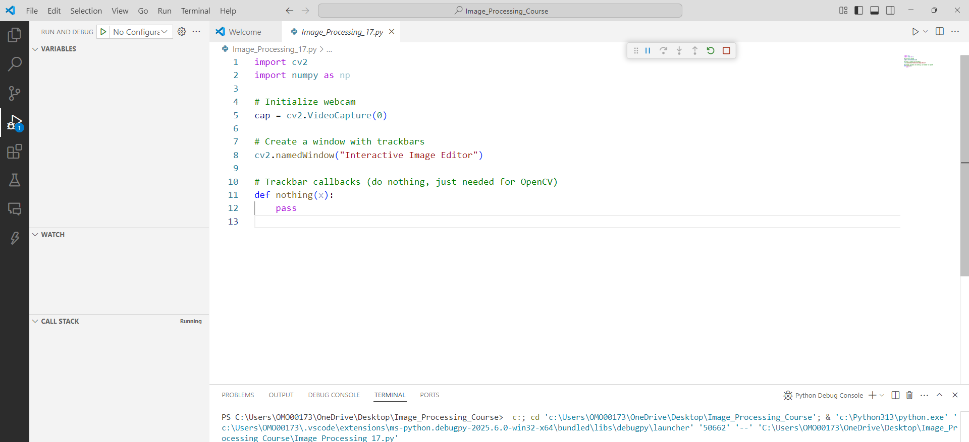
Code Output:

Slide 5
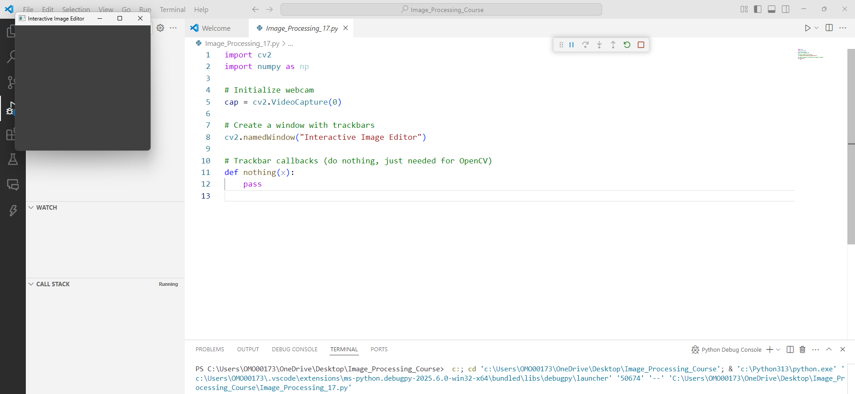
Code Output:

Slide 6
Project Code : Part 2/7 : Interactive Image Editor with OpenCV
# Create trackbars for brightness, contrast, and filters
cv2.createTrackbar("Brightness", "Interactive Image Editor", 50, 100, nothing)
cv2.createTrackbar("Contrast", "Interactive Image Editor", 50, 100, nothing)
cv2.createTrackbar("Filter", "Interactive Image Editor", 0, 5, nothing) # 0: None, 1: Grayscale, 2: Blur, 3: Edges, 4: Sketch, 5: Invert
cv2.createTrackbar("Rotation", "Interactive Image Editor", 0, 360, nothing)
cv2.createTrackbar("Flip", "Interactive Image Editor", 0, 2, nothing) # 0: None, 1: Horizontal, 2: Vertical
# Drawing mode variables
drawing = False
ix, iy = -1, -1
color = (0, 255, 0) # Green
thickness = 2

Slide 7
Project Code :Part 3/7: Interactive Image Editor with OpenCV
# Mouse callback for drawing
def draw(event, x, y, flags, param):
global ix, iy, drawing, img
if event == cv2.EVENT_LBUTTONDOWN:
drawing = True
ix, iy = x, y
elif event == cv2.EVENT_MOUSEMOVE:
if drawing:
cv2.line(img, (ix, iy), (x, y), color, thickness)
ix, iy = x, y
elif event == cv2.EVENT_LBUTTONUP:
drawing = False
cv2.line(img, (ix, iy), (x, y), color, thickness)

Slide 8
Project Code :Part 4/7: Interactive Image Editor with OpenCV
cv2.setMouseCallback("Interactive Image Editor", draw)
while True:
# Read frame from webcam
ret, img = cap.read()
if not ret:
break
# Get trackbar values
brightness = cv2.getTrackbarPos("Brightness", "Interactive Image Editor") - 50
contrast = cv2.getTrackbarPos("Contrast", "Interactive Image Editor") / 50
filter_mode = cv2.getTrackbarPos("Filter", "Interactive Image Editor")
rotation = cv2.getTrackbarPos("Rotation", "Interactive Image Editor")
flip_mode = cv2.getTrackbarPos("Flip", "Interactive Image Editor")

Slide 9
Project Code :Part 5/7: Interactive Image Editor with OpenCV
# Adjust brightness & contrast (Section 5)
img = cv2.convertScaleAbs(img, alpha=contrast, beta=brightness)
# Apply filters (Section 6)
if filter_mode == 1: # Grayscale
img = cv2.cvtColor(img, cv2.COLOR_BGR2GRAY)
img = cv2.cvtColor(img, cv2.COLOR_GRAY2BGR)
elif filter_mode == 2: # Blur
img = cv2.GaussianBlur(img, (15, 15), 0)
elif filter_mode == 3: # Edge Detection
gray = cv2.cvtColor(img, cv2.COLOR_BGR2GRAY)
edges = cv2.Canny(gray, 100, 200)
img = cv2.cvtColor(edges, cv2.COLOR_GRAY2BGR)

Slide 10
Project Code :Part 6/7: Interactive Image Editor with OpenCV
elif filter_mode == 4: # Pencil Sketch
gray = cv2.cvtColor(img, cv2.COLOR_BGR2GRAY)
inverted = cv2.bitwise_not(gray)
blurred = cv2.GaussianBlur(inverted, (21, 21), 0)
sketch = cv2.divide(gray, blurred, scale=256.0)
img = cv2.cvtColor(sketch, cv2.COLOR_GRAY2BGR)
elif filter_mode == 5: # Invert Colors
img = cv2.bitwise_not(img)
# Rotate image (Section 10)
if rotation != 0:
h, w = img.shape[:2]
M = cv2.getRotationMatrix2D((w//2, h//2), rotation, 1.0)
img = cv2.warpAffine(img, M, (w, h))

Slide 11
Project Code :Part 7/7: Interactive Image Editor with OpenCV
# Flip image (Section 10)
if flip_mode == 1:
img = cv2.flip(img, 1) # Horizontal flip
elif flip_mode == 2:
img = cv2.flip(img, 0) # Vertical flip
# Add text (Section 8)
cv2.putText(img, "OpenCV Mini Project", (10, 30), cv2.FONT_HERSHEY_SIMPLEX, 0.7, (255, 0, 0), 2)
# Display the image
cv2.imshow("Interactive Image Editor", img)
# Exit on 'ESC' key
if cv2.waitKey(1) == 27:
break
# Release resources
cap.release()
cv2.destroyAllWindows()

Slide 12
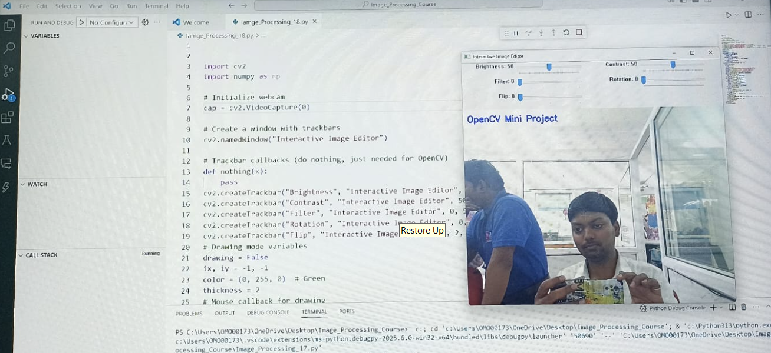
Mini Project Output:

Slide 13
Thank- You !

